Slide 1
My Mother Went
To Vietnam:
Anecdotal Stories of
Servant Leadership
Megan Seibel, RN, PhD
McComas Staff Leadership Seminar
April 26, 2017

Slide 2
Leadership for Others
Guidance of Others
Care and Concern for the Betterment of Others

Slide 3
“The servant-leader is servant first… It begins with the natural feeling that one wants to serve, to serve first. Then conscious choice brings one to aspire to lead. That person is sharply different from one who is leader first, perhaps because of the need to assuage an unusual power drive or to acquire material possessions…The leader-first and the servant-first are two extreme types. Between them there are shadings and blends that are part of the infinite variety of human nature.
A servant-leader focuses primarily on the growth and well-being of people and the communities to which they belong. While traditional leadership generally involves the accumulation and exercise of power by one at the “top of the pyramid,” servant leadership is different. The servant-leader shares power, puts the needs of others first and helps people develop and perform as highly as possible.
https://www.greenleaf.org/what-is-servant-leadership/

Slide 4
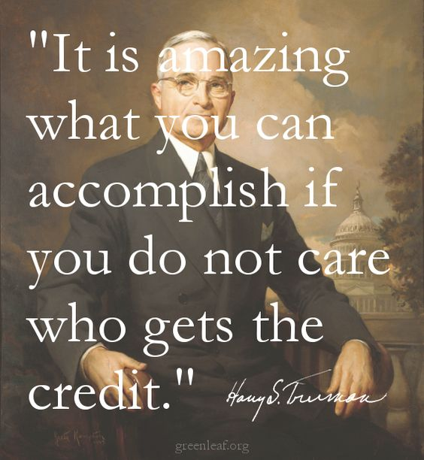
Notes:
Basil and current admin

Slide 5
9 Qualities of the Servant Leader
1: Values diverse opinions
2: Cultivates a culture of trust
3: Develops other leaders
4: Helps people with life issues
5: Encourages
6: Sells instead of tells
7: Thinks you, not me
8: Thinks long-term
9: Acts with humility
https://www.skipprichard.com/9-qualities-of-the-servant-leader/

Slide 6
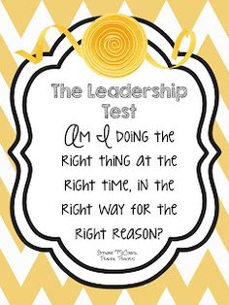
https://s-media-cache-ak0.pinimg.com/236x/12/fa/80/12fa8099c99c91d387bc75a22d92944a.jpg?noindex=1

Slide 7
You Are Perfect Enough

Slide 8
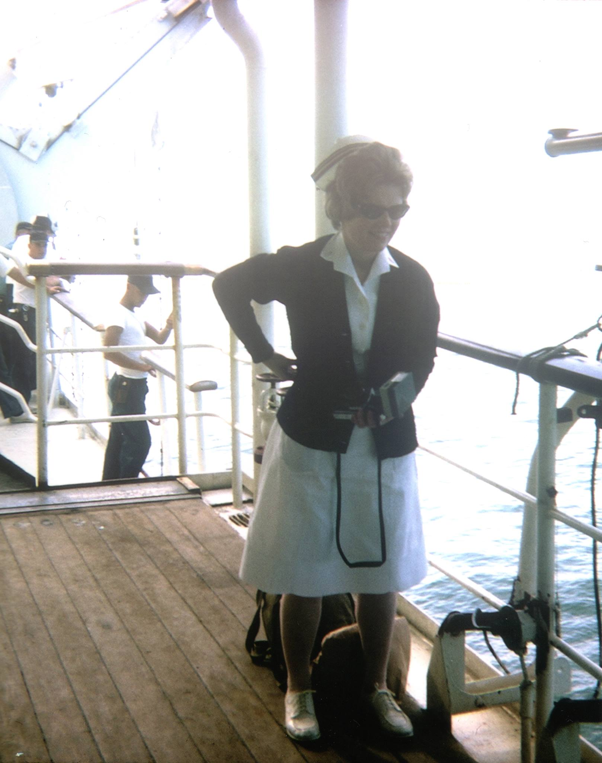

Slide 9
Stephen

Slide 10
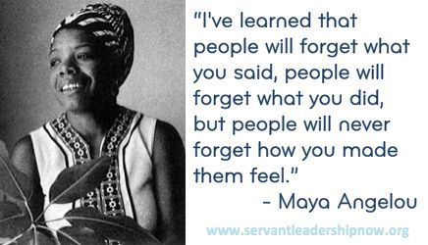

Slide 12
Loving Banter and Humor

Slide 13
Mega jefe

Slide 14
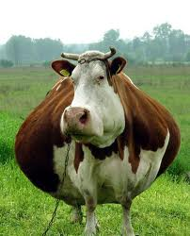

Slide 15
Serenity to accept the things we cannot change
Courage to change those we can
Wisdom to know the difference

Slide 16
The Value of
Cognitive Diversity in a
Complex World

Slide 17
Thank You!
The End

Slide 18
mseibel@vt.edu
Presentation template credit to: www.presentationmagazine.com

