Slide 1
Servant Leadership is Dependent on
YOUR Happiness
Dr. Patty Perillo
Vice President for Student Affairs
April 26, 2017

Slide 2
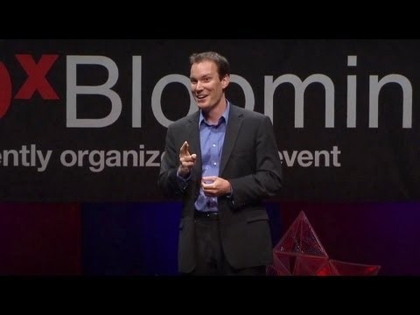

Slide 3
LET’S START NOW…
Meditation
Gratitude
Get a Journal

Slide 4
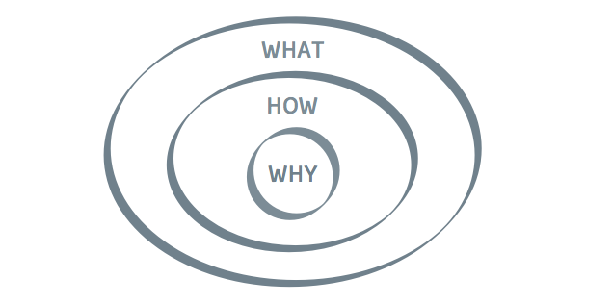

Slide 5
KNOW YOUR VALUES

Slide 6
MY VALUES =
LIVED VALUES

Slide 7
How My Values Reveal Themselves
ASPIRATIONS FOR STUDENT LEARNING
Commit to unwavering curiosity
Pursue self-understanding and integrity
Practice civility
Prepare for a life of courageous leadership
Embrace Ut Prosim as a way of life

Slide 8
How My Values Reveal Themselves
Leadership Circles
Office Hours
Patty-gogy
Monthly Notes
Fall Town Hall
Spring Renewal
Daily, Weekly & Monthly Gratitude & Our Gratitude Lunch
Acorn Awards

Slide 9
